Slide 1


Team 6

Slide 2

What went right
Group Meetings – Google Hangout allowed us to conduct our meetings efficiently and fluently. We were able to share updated code as well as discuss next steps for completing the project.
Unit Tests – Testing went well and allowed us to easily determine where the faults were.
Team Collaboration – Everyone was very helpful in regards to any questions/comments/concerns the other group member had.

Slide 3
What went wrong
Source Forge Set Up – The initial set up for our team on Source Forge gave us some difficulties. Being the first time we used this repository, it took a while to get the swing of things.
Mac Issues – Initially, the game did not run on Macintosh Computers, making it hard for testing for half of our team at certain times.
Locating and fixing uncommon bugs

Slide 4
About the project
Used GIT as opposed to SVN.
We all tested the code to ensure functionality worked.
We all fixed minor issues with the code.

Slide 5

Jesse meadows
Commented most the code.
Reimplemented Background scrolling.
Fixed general issue with code, (scrolling bug for example).
Scrolling bug for example.

Slide 6
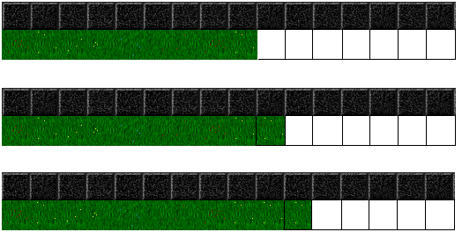
Background compilation
BEFORE
Each individual tile’s image loaded by referencing tile’s image and superimposing that image on the canvas
This results in 224 (14 tiles x 16 tiles) tile’s needing to be super imposed each frame

Slide 7
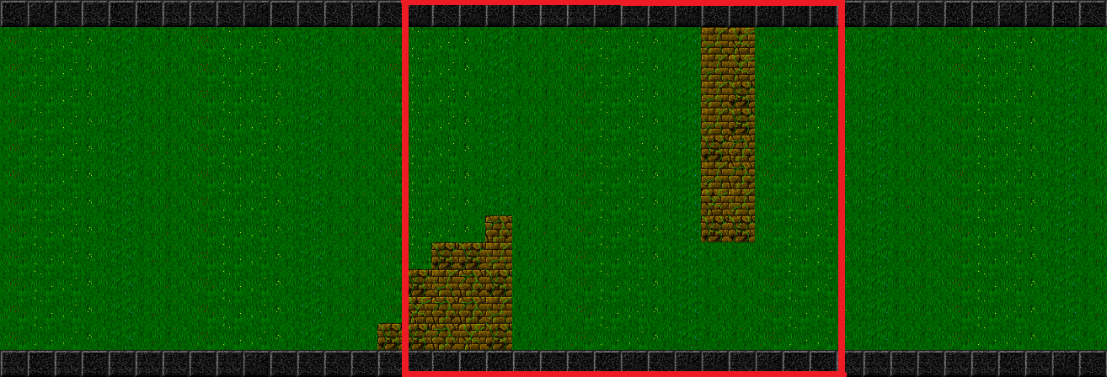
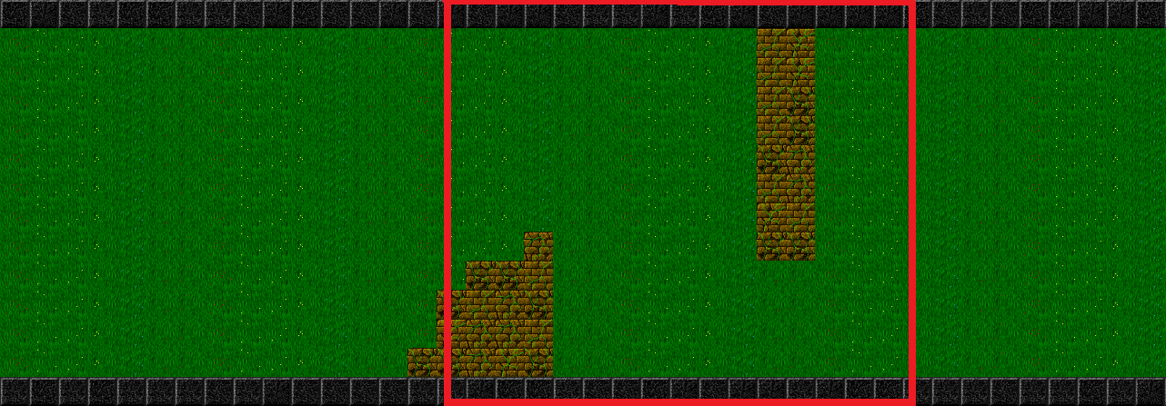
After Refactor

Slide 8


Missing Collision frame
Bullet’s typically don’t show contact before disappearing
Goal →

Slide 9
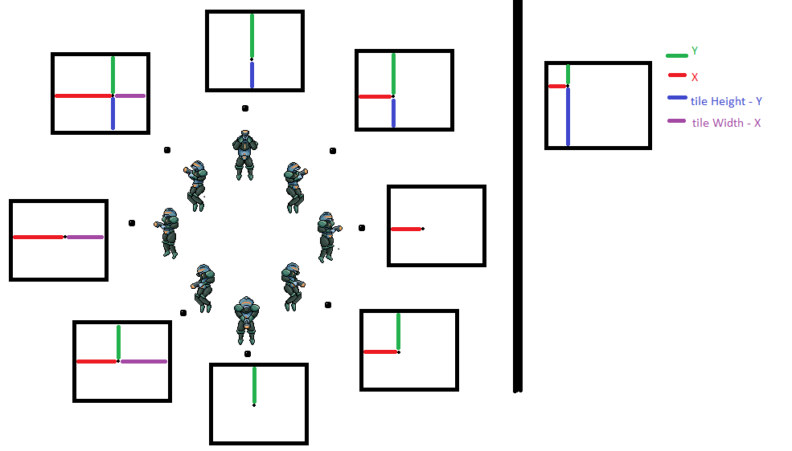

Slide 10
Trent wilson
Created meeting minutes.
Developed agenda for group weekly.
Updated the code to fix Flyer Spawn Problem.
Proposed a solution to wall-collision multiple death problem.
Designed a second “Concept” Level after Boss.

Slide 11

Phil wernersbach
Fixed issues with collisions
Collisions from both the left and right sides work!
Implemented Graphics2DMock
Fixed miscellaneous bugs

Slide 12

Trey hope
Fixed issues with normalizing in Vector2 class.
Created project presentation.

Slide 13
Aaron disibio
Created Boss implementation in Fury Fighter.
Created Boss graphics.

Slide 14


Feature added
Implemented, “BOSS”, (BossModel.java)

Slide 15

Boss
Boss has 100 life.
Moves around the screen and has three points of weakness, (the blinking guns).
Shoots three bullets towards the player.
Has a spinning arm that kills player on contact.
Has a 1/60 chance to shoot per update.

Slide 16

Boss Berserk mode
When the boss is low on life it switches to Berserk mode.
Movement is now restricted to y axis but the speed is tripled.
Shooting speed now 1/30.
Arm rotation reverses direction and rotation speed is doubled.
Arm is one unit longer than before.

Slide 17

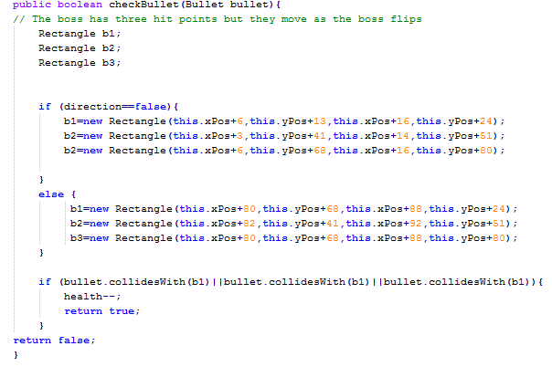
Boss code example
Arm movement:
Three weak points:

Slide 18

Let’s play!

